Slide 1
User Self-Triage Model using Tree Based Methods
Paul Butler

Slide 2
The Problem
Most people are not medical professionals and lack the knowledge to accurately determine when to seek medical care.
Combined with high medical care costs, this can create a disincentive to seek appropriate care.
To solve this problem we need an easy way for people to answer two questions:
Do I need care?
How quickly should I seek care?

Slide 3
Data Set
Data for 4920 patients from a third world area.
133 symptoms:
Binary Presenting/ not presenting classifier
Medical diagnosis
41 categorical diagnoses

Slide 4
Initial problems for Data Set
Missing column
Mislabeled column
Data was multicollinear
Data leakage with first decision tree model

Slide 5
Cleaning Highly Related symptoms
Strong relationships between symptoms were detected using Cramer’s V
Any relationship > 0.3 was then cleaned by
Dropping the symptom(s) that non medically trained persons could not identify.
Dropping all but one symptom in highly related clusters of symptoms.
Dropping the symptom that non medically trained persons would be more likely to inaccurately identify.

Slide 6

Cramer’s V results before cleaning
Many hotspots of interrelated symptoms > 0.3 present.
An example of two hotspots with high relationships:
 | weight_gain | Cold_hands_and_feets
puffy_face_and_eyes | 0.89 | 0.89
enlarged_thyroid | 0.94 | 0.94
brittle_nails | 0.94 | 0.94
swollen_extremeties | 0.94 | 0.94

Slide 7

Cramer’s V results Cleaning Example
Dropping “weight_gain” and “cold_hands_and_feets” eliminates the high relationships between these 2 variables and the 4 other variables

Slide 8
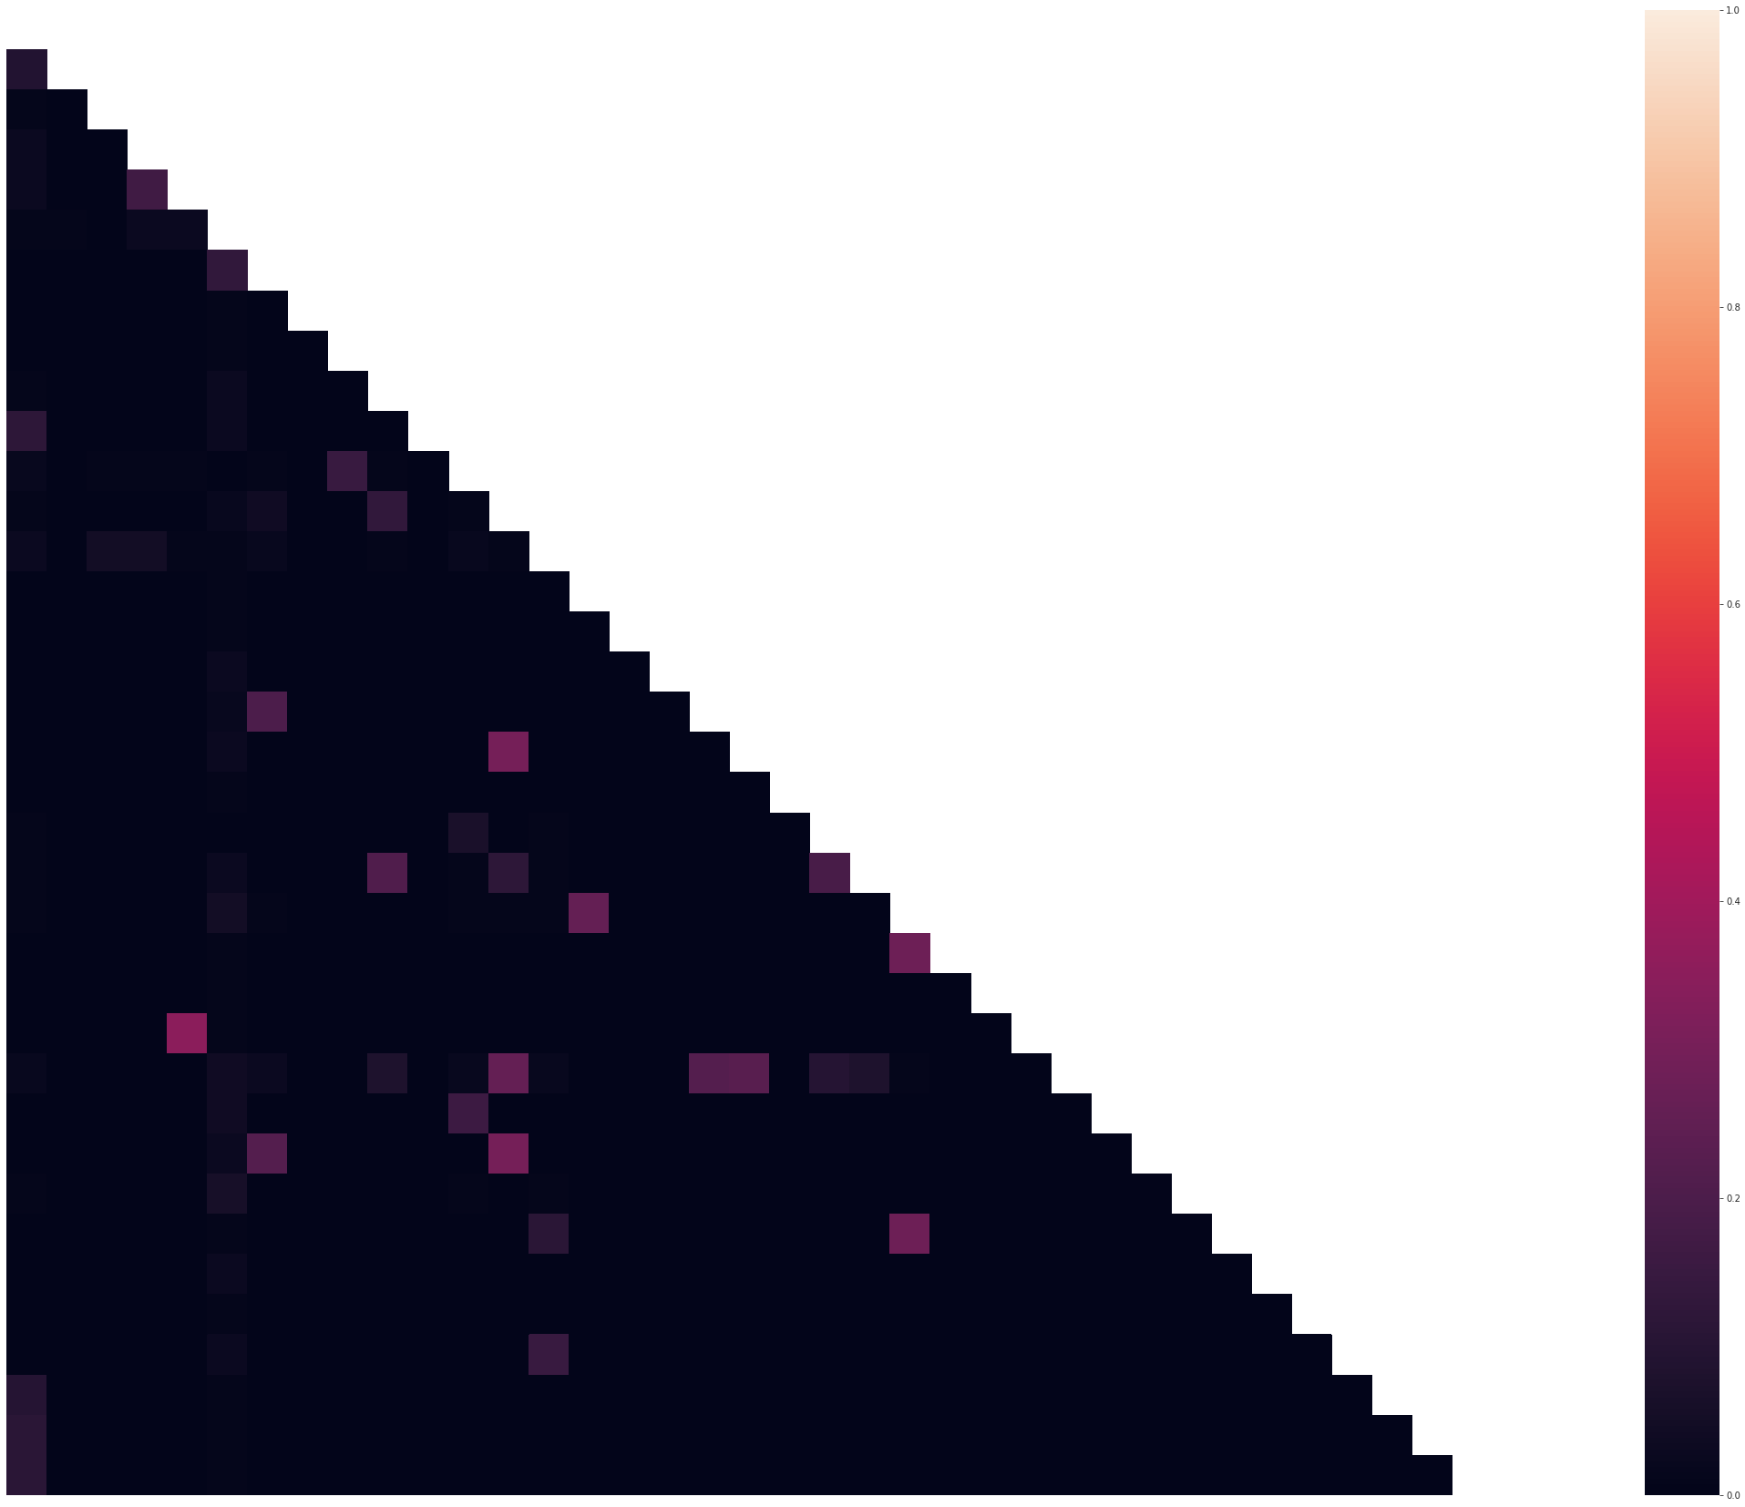
Cramer’s V results After cleaning
All hotspots > 0.3 eliminated from the dataset.
36 symptoms remaining

Slide 9
Remaining Features overview
36 remaining features
Features vary by severity and system affected
Severe
Example: weakness_of_one_body_side(neurological), muscle_weakness(mudculoskeletal)
Moderate
Example: stomach_pain(gastrointestinal) , skin_rash(dermatological)
Mild
stiff_neck(musculoskeletal), fatigue (multisystem)
Features can be acute, chronic, or risk factors for example (history_of_alcoholism)

Slide 10
Creating the Decision Trees Model
Decision Trees Model
Model overview:
Predictive features: 36 Symptoms
Target variable: Triage Classification (4 possible outcomes)
Technologies used
Scikit-learn for model building.

Slide 11
Decision Trees Model Steps
Split data using stratified 80/20 train/test split.
This allows part of the data to be unseen by the model until testing – this allows us to confirm accuracy of model.
Gini criterion
Random State = 42

Slide 12
Decision Trees Model Accuracy
Training Accuracy: 90%
Testing Accuracy: 88%
This indicates that the model is very accurate overall, but is slightly overfitted
Overall F1 Score: 0.89

Slide 13
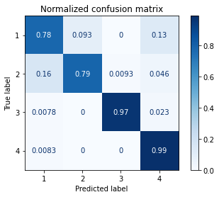
Decision Trees Accuracy Cont.
Significant differences between classes in confusion matrix
F1 scores for class 1 & 2 significantly lower than class 3 & 4.
Large difference between precisions and recall for class 4

Slide 14
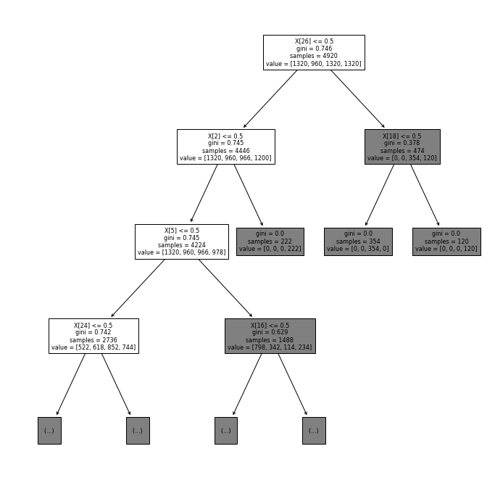
Decision Trees Structure
30 Levels
113 nodes

Slide 15
Can We Do Better?
Let's try again with a Random Forests Model

Slide 16
Creating The Random Forests model
Random forest model implemented
Model overview:
Predictive features: 36 Symptoms
Target variable: Triage Classification (4 possible outcomes)
Technologies used
Scikit-learn for model building.

Slide 17
Random Forests Model Steps
Split data using stratified 80/20 train/test split.
This allows part of the data to be unseen by the model until testing – this allows us to confirm accuracy of model.
10 estimators and entropy criterion
Random State = 42

Slide 18
Random Forests Model Accuracy
Same Results as Decision Tree Model
Training Accuracy: 90%
Testing Accuracy: 88%
This indicates that the model is very accurate overall, but is slightly overfitted
Overall F1 Score: 0.89

Slide 19
Random Forests Accuracy Cont.
Same Results as Decision Tree Model
Significant differences between classes in confusion matrix
F1 scores for class 1 & 2 significantly lower than class 3 & 4.
Large difference between precisions and recall for class 4

Slide 20
Further Random Forrest Model Explanations
Recursive Feature Dropping
8 Features not contributing to model
SHapley Additive exPlanations (SHAP)
All Features contribute to each class, but in varying degrees

Slide 21
Recursive Feature Dropping
Feature | Impact
indigestion | 0
blurred_and_distorted_vision | 0
puffy_face_and_eyes | 0
slurred_speech | 0
muscle_weakness | 0
lack_of_concentration | 0
blood_in_sputum | 0
silver_like_dusting | 0
weakness_in_limbs | -0.00081
loss_of_balance | -0.00081
pus_filled_pimples | -0.00081
8 Features did not contribute to model
3 Negative Features
25 Positive Features
This was not the same finding as SHAP

Slide 22
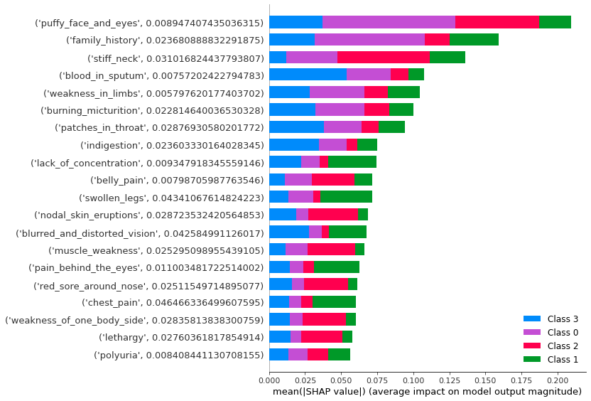
SHapley Additive exPlanations (SHAP)
All features contribute to each class, but in varying degrees
Some feature contribute significantly to one class, and then less to others.
Some features moderately contribute to two classes, and then less to the other two

Slide 23
Conclusions
This model is a good first step
Random Forests does not have superior performance to decision trees in this case
As dataset gets larger in future versions, this pattern may not hold.
Test production pilot in representative area
Gather more data for future versions
Future versions
Expand number of diseases triaged
Use more symptoms as predictors

